Slide 1



Program
Name
Lecture name
Presented by: Name Here

Slide 2

Outline
Use Bullet points for each topic
Topic One
Topic Two
Topic Three

Slide 3


Design Format
Listings
Maintain the same listing design format for all slides
Use bullet points for guidance (make sure points are short and precise)
Use numbering when explaining a process steps only

Slide 4
Design Format
Process
1
Step One
2
Step two
3
Step Three

Slide 5
Title
Subtitle or definition to be put here defining the topic title
Point to cover one
Point to cover two
Point to cover three
Point to cover four

Slide 6
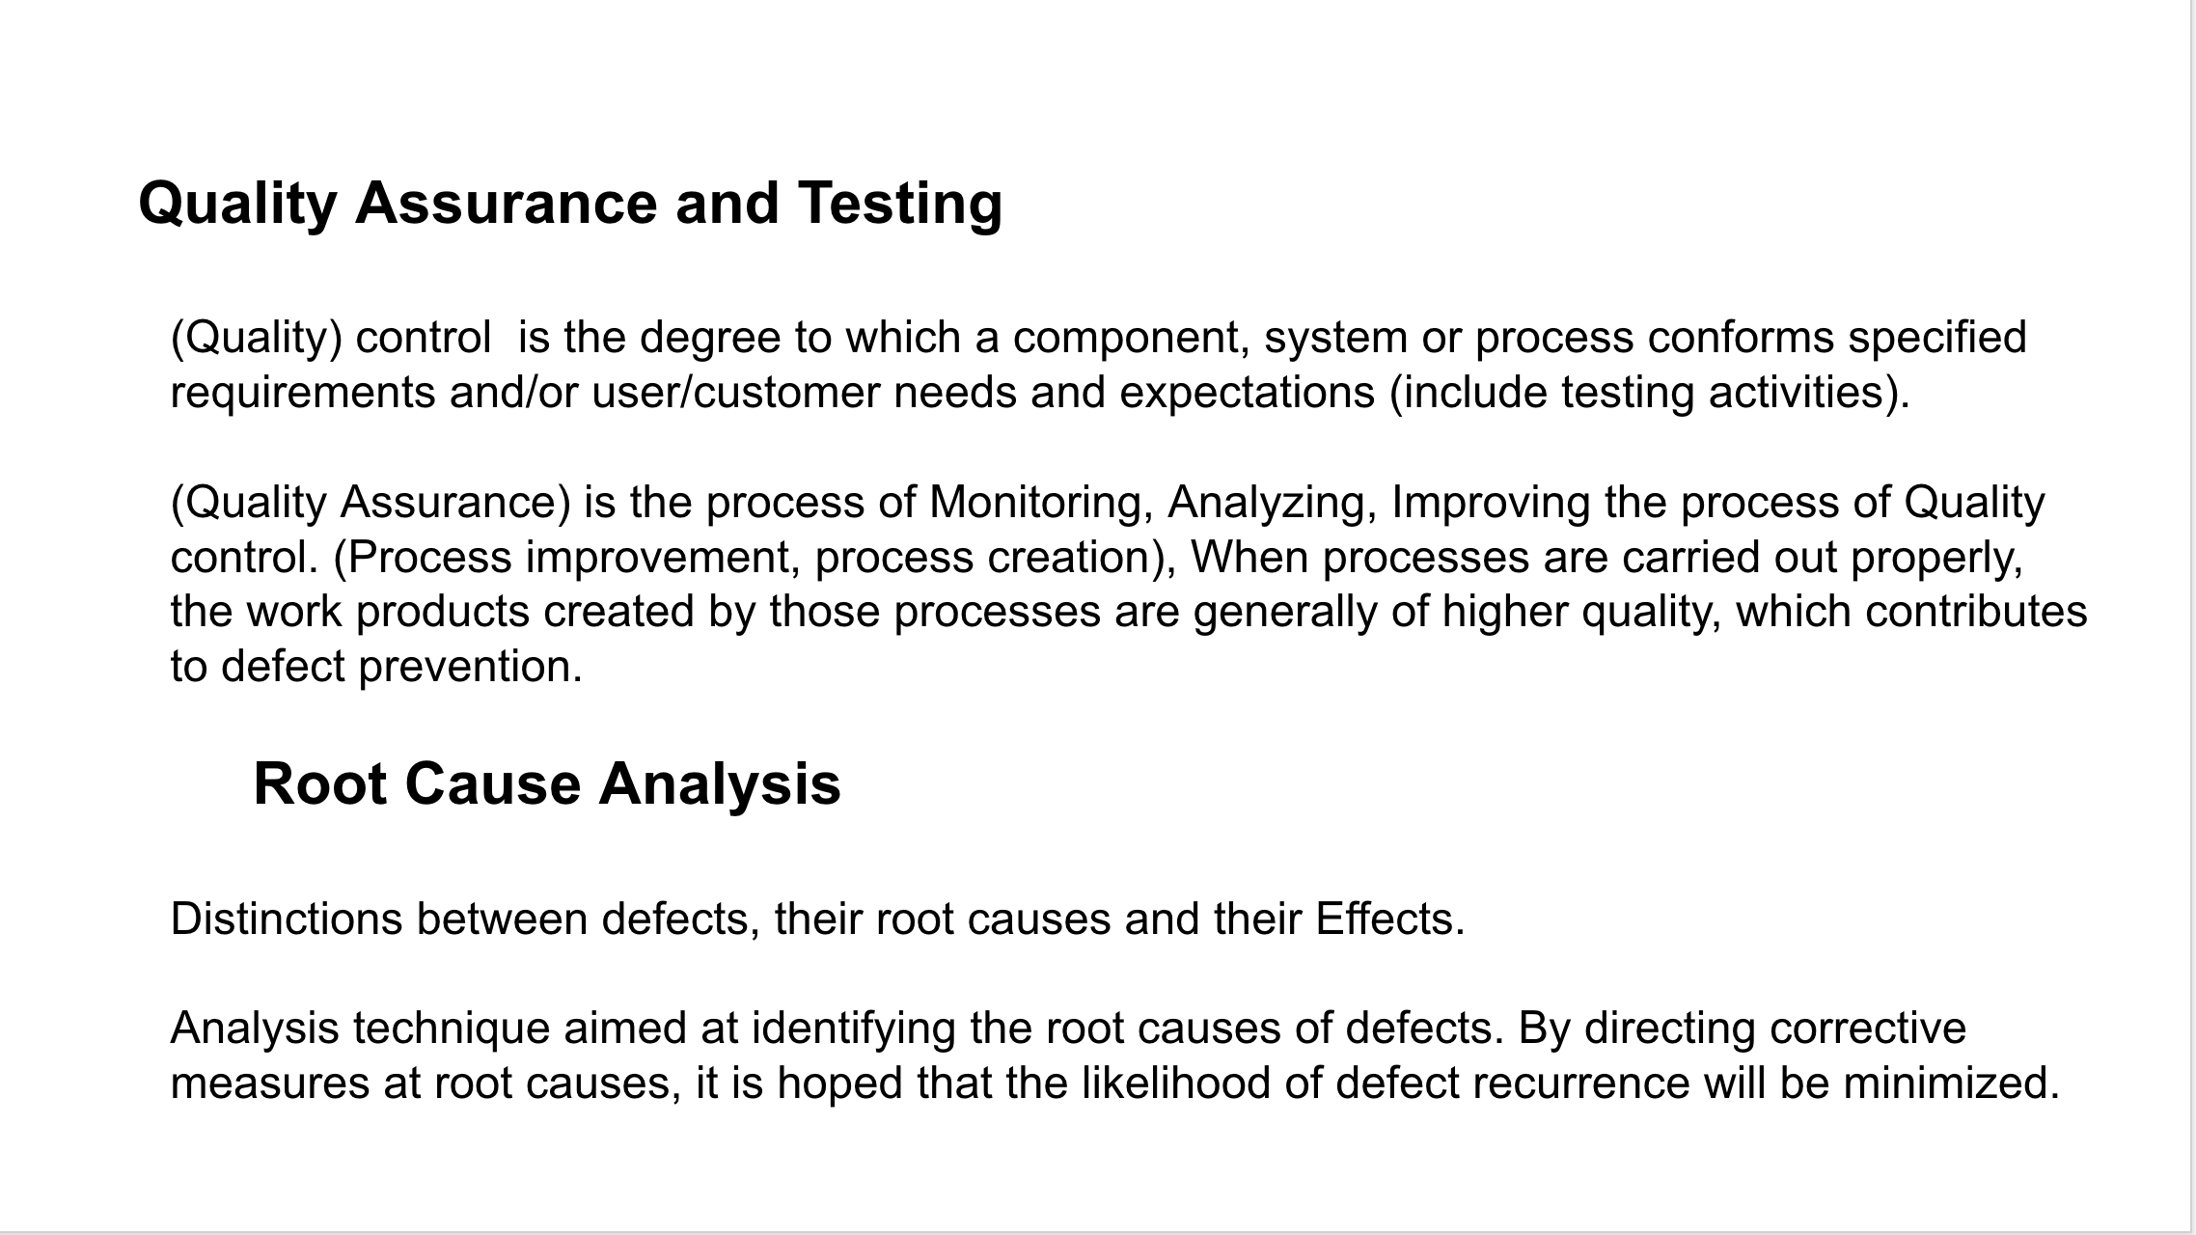



Explanation Slide
Only Contain two to three paragraphs per slide
Use bold or Italic typeface to highlight important points within a paragraph

Slide 7
Title
Subtitle

Slide 8
Title

Slide 9

Images and Graphs
Use images and graphs in high quality
( Avoid Pixelated Images)
Maintain balance and ratio between image and text on the slide (Image on one side, text on the other)

Slide 10

Mathematical Text
Simplify mathematical text and write it in text format when applicable
Instead of:
\text{fraction} = \frac{\text (numerator}} (\text (denominator]}
Write:
numerator
denominator
Fraction =

Slide 11







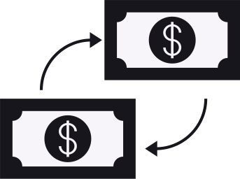
















Template Resources
Use these recolorable icons and illustrations in your ppt
Font: - Montserrat (Bold) for titles
- Montserrat (Regular) for body

